Slide 1

Data Visualization Accessibility
Workshop, Visualizing Knowledge, Jun 2023
axle-lab.com
Thinking about data visualization for people with disabilities.
Frank Elavsky, PhD student at Carnegie Mellon University

Slide 2
Today’s agenda
Part 1: 1 hour + 10 minute break
Important concepts in accessibility and disability
Cool emerging work, Q/A, and sharing
Part 2: 50 minutes + 10 minute break
How to catch accessibility barriers in a visualization
Part 3: 50 minutes
Hands-on exploration of different kinds of data representation

Slide 3
Who am I? A data visualization + accessibility researcher and engineer
Research: Carnegie Mellon and Apple.
Organize: DataVizA11y.
Contribute: W3C’s ARIA Working Group as an invited expert.
Create: Tools for designers and engineers who want to make accessible visualizations.

Slide 4
Creators
4

Slide 5
Creators
Tools
5

Slide 6
Creators
Tools
Things
6

Slide 7
Creators
Tools
Things
Future Things
7

Slide 8
But how much of this is inaccessible?
Creators
Tools
Things
Future Things
8

Slide 9
97-99.9%
Creators
Tools
Things
Future Things
Source: World Wide Web Consortium. “The WebAIM Million.”
9

Slide 10
Dreaming of ideals
Creators
Tools
Things
Future Things
10
Notes:
Common, the way most people do this work

Slide 11
The knowledgeable “specialist” intervenes
Creators
Tools
Things
Future Things
11
Notes:
Common, the way most people do this work

Slide 12
We change our systems, laws, and environments
Creators
Tools
Things
Future Things
12

Slide 13
We give creators better tools
Creators
Tools
Things
Future Things
13

Slide 14
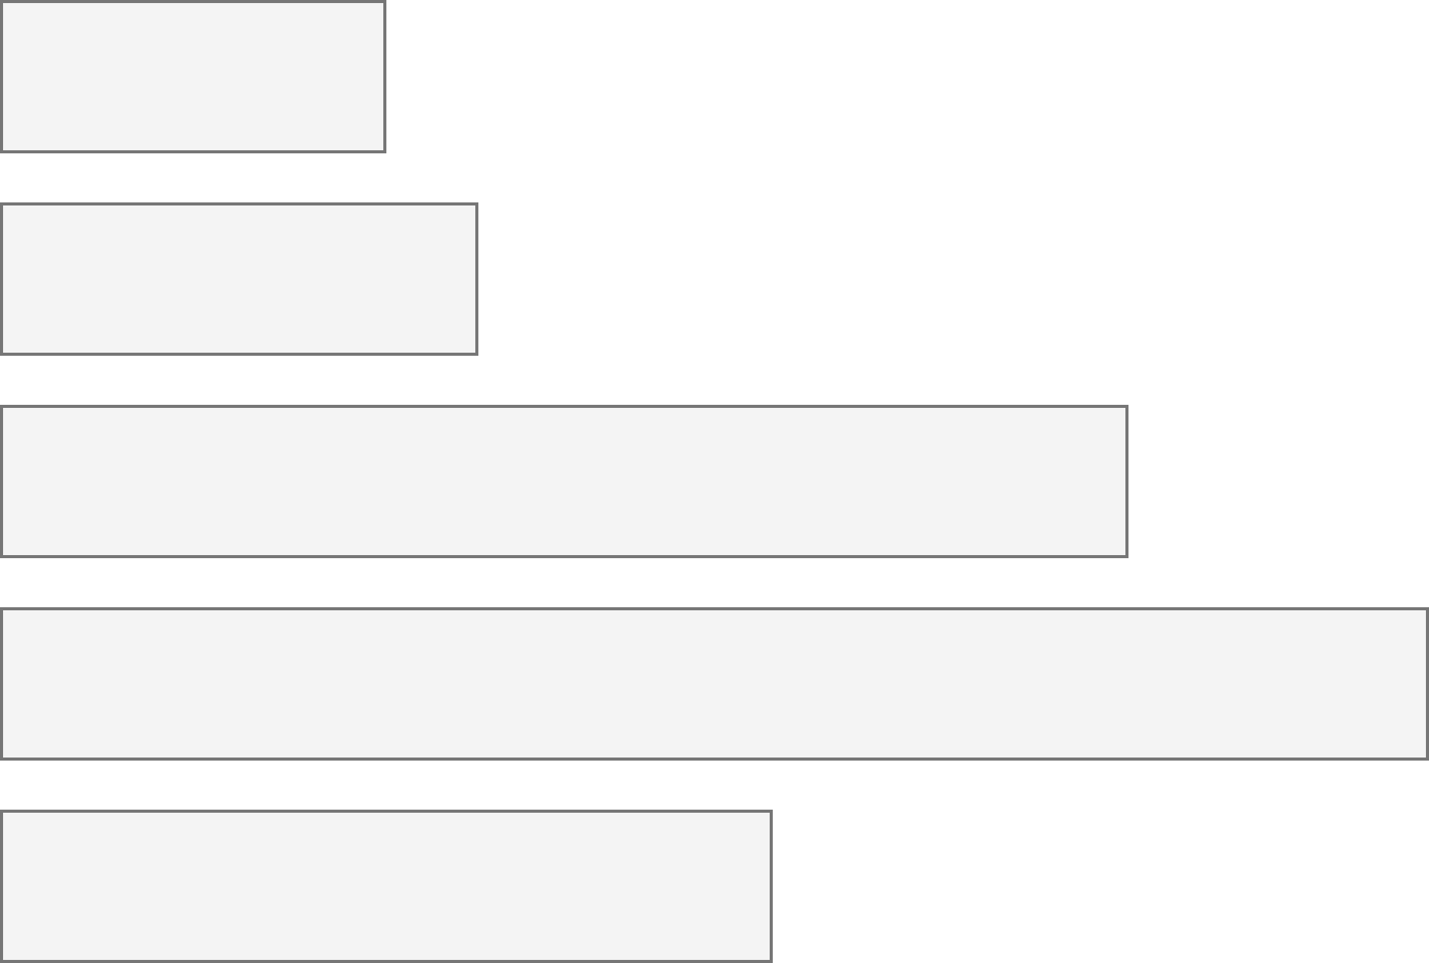
26% of people living in the United States self-report living with a disability that affects their daily life.
4.1%
Color Vision Deficiency
4.5%
Blindness, Low Vision
10.8%
Cognitive, Neurological
13.7%
Motor, Dexterity
7.4%
Vestibular, Motion
Source: Okoro et al. “Prevalence of Disabilities and Health Care Access by Disability Status and Type Among Adults”
Introduction - Example - Design - Evaluation - Results - Future Work
Notes:
But how do designers, developers, and creators of visualizations know whether something they’ve made is accessible or not for people with disabilities?

Slide 15
Every area of disability affects data visualization work.
Color Vision Deficiency
Visual design
4.1%
Non-visual design
4.5%
Blindness, Low Vision
Narrative design, statistics, storytelling
10.8%
Cognitive, Neurological
13.7%
Motor, Dexterity
Interaction design, device considerations, performance
7.4%
Vestibular, Motion
Animation, transitions
Introduction - Example - Design - Evaluation - Results - Future Work
Notes:
But how do designers, developers, and creators of visualizations know whether something they’ve made is accessible or not for people with disabilities?

Slide 16
What you will learn today
What is accessibility?
What are the social and medical models of disability?
What are “ability assumptions”?
What is “situational” disability or impairment?
What are some recent advancements?

Slide 17
Discuss: What is accessibility?
Bonus discussion:
What is “Inclusive Design” and how is it different from accessibility?

Slide 18
Accessibility (some working definitions):
1. The qualities that make an experience open or usable to all.
2. The qualities that make an experience open or usable specifically for people with disabilities.

Slide 19
26% are disabled. Now what?
4.1%
Color Vision Deficiency
4.5%
Blindness, Low Vision
10.8%
Cognitive, Neurological
13.7%
Motor, Dexterity
7.4%
Vestibular, Motion
Source: Okoro et al. “Prevalence of Disabilities and Health Care Access by Disability Status and Type Among Adults”
Introduction - Example - Design - Evaluation - Results - Future Work
Notes:
But how do designers, developers, and creators of visualizations know whether something they’ve made is accessible or not for people with disabilities?

Slide 20
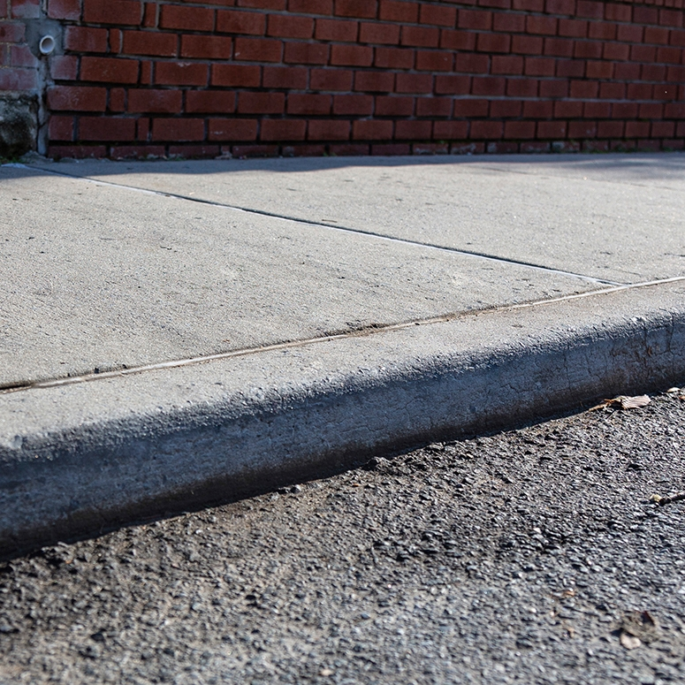
Concept: social vs medical models of disability
a “curb”

Slide 21
What do we do about curbs in our cities?

Slide 22
Medical model: the body is the cause of disability (according to normative standards).

Slide 23
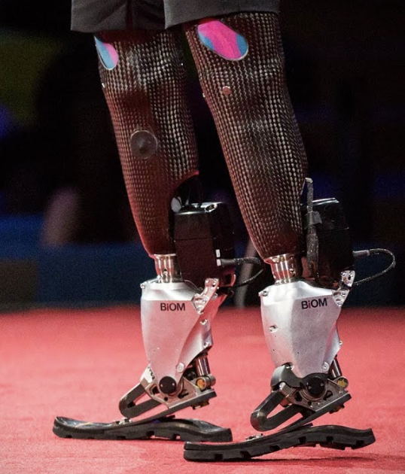
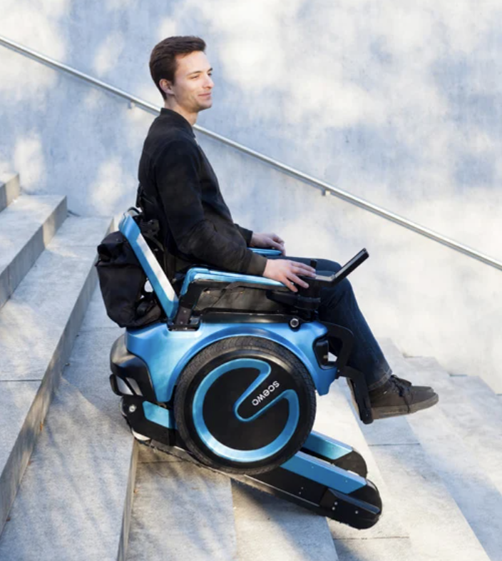
Medical model: augment or “cure” the body.

Slide 24
Social model: The curb is the source of disability (a “barrier” to access).

Slide 25
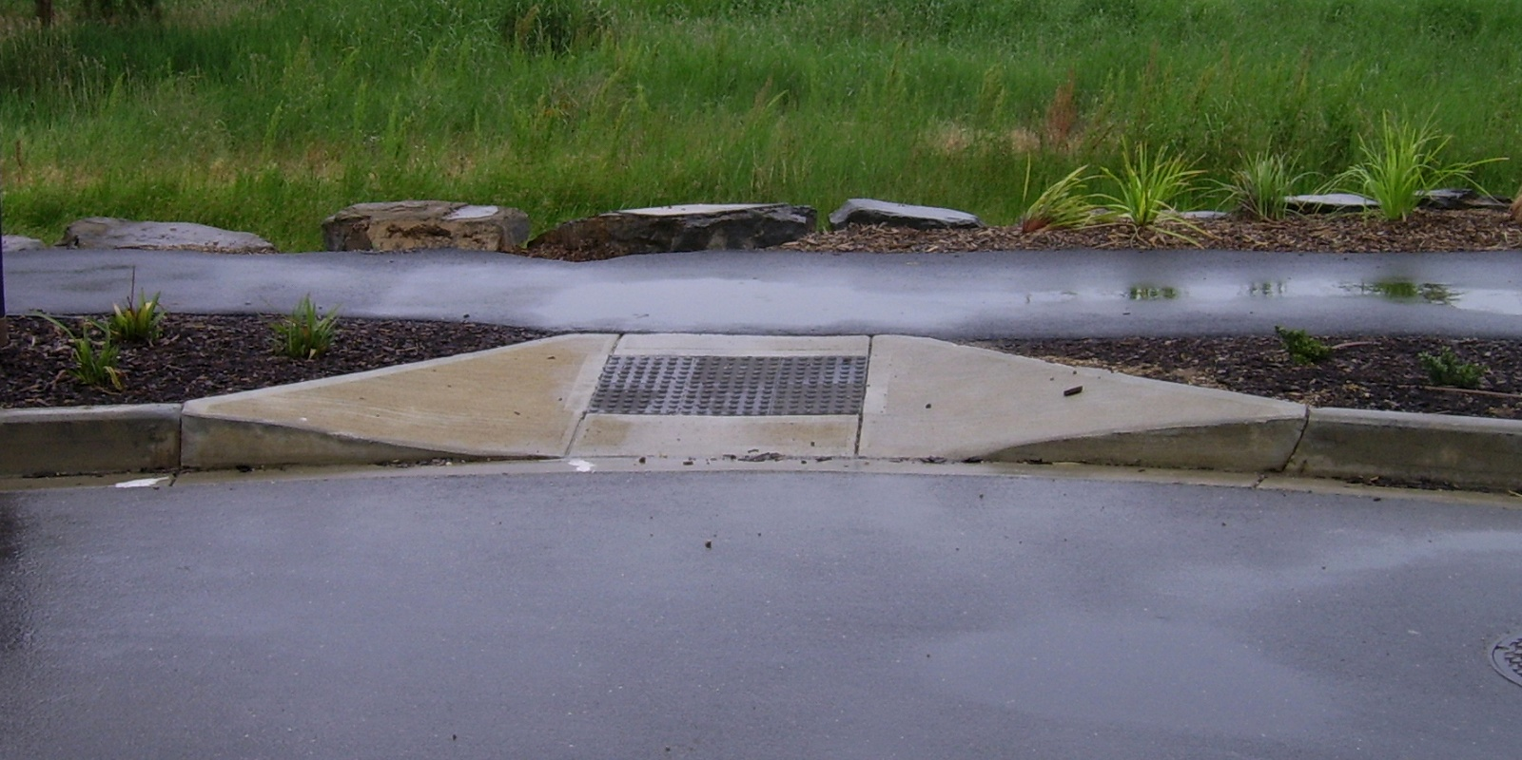
Social model: Cut the curb.

Slide 26
Discuss: Why do people do this work?

Slide 27

Access is a human right
Accessibility is an internationally recognized human right.
It is the morally and ethically correct thing to do.
https://www.un.org/development/desa/disabilities/convention-on-the-rights-of-persons-with-disabilities/article-9-accessibility.html
https://www.un.org/development/desa/disabilities/convention-on-the-rights-of-persons-with-disabilities/article-10-right-to-life.html

Slide 28
It is expensive to exclude accessibility

Slide 29
15% of time spent on accessibility…
… for 26% of all people
It is expensive to exclude accessibility

Slide 30
Fixing inaccessibility takes 1.5 – 10x more time if done after something is built.

Slide 31
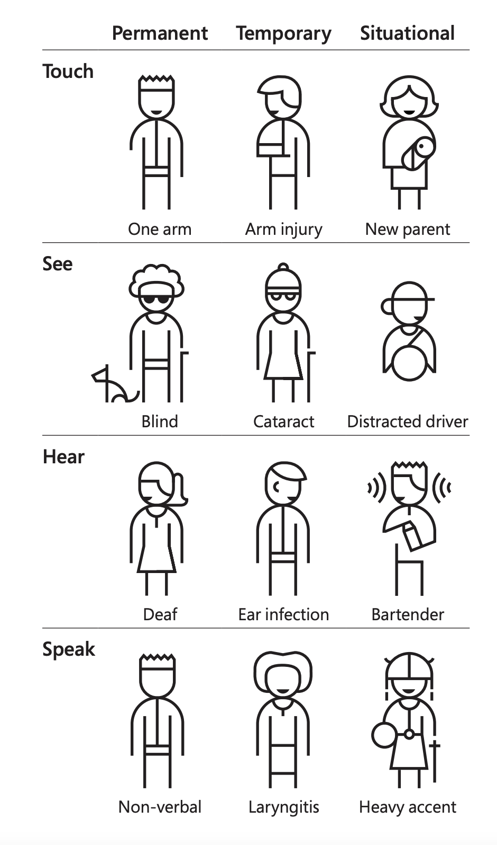
Concept: Situational Impairment “Design for One, Extend to All”
Microsoft’s Inclusive Design 101 Toolkit: https://download.microsoft.com/download/b/0/d/b0d4bf87-09ce-4417-8f28-d60703d672ed/inclusive_toolkit_manual_final.pdf

Slide 32
We all experience situational impairment in our daily lives. Accessibility benefits everyone!

Slide 33
Discuss: Share an example where you might be impaired in some way and how accessible technology or infrastructure helps you.

Slide 34
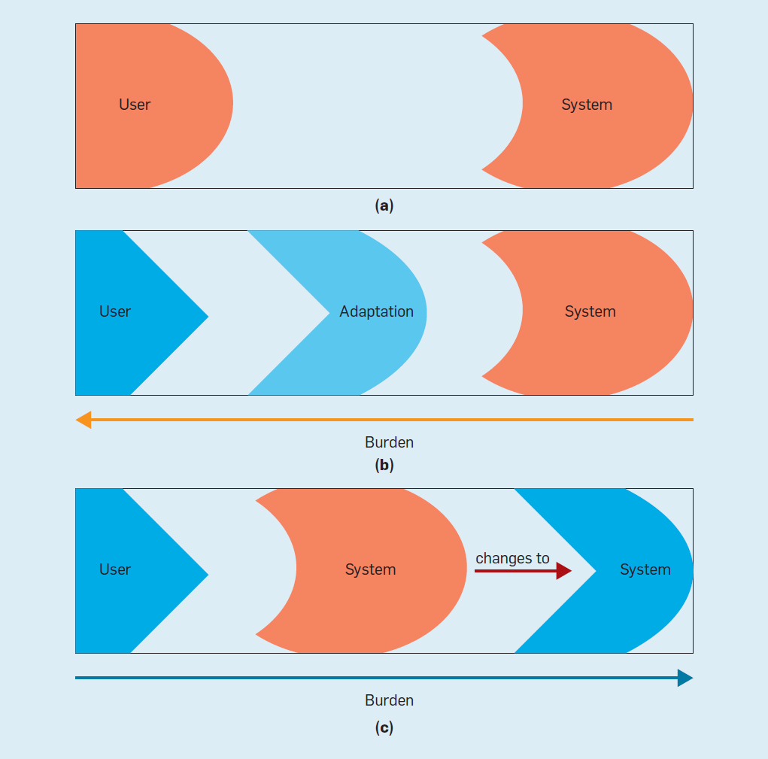
Concept: Ability Assumptions
(Wobbrock et al) https://cacm.acm.org/magazines/2018/6/228034-ability-based-design/fulltext

Slide 35
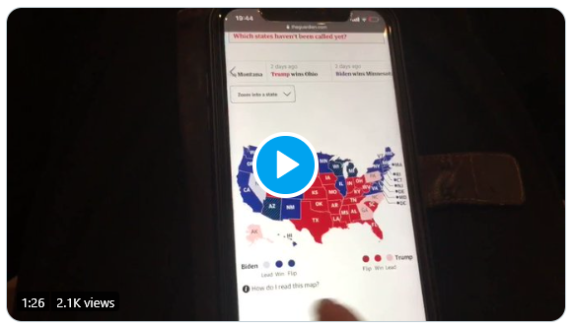
What is an inaccessible experience like?
Credit: Sarah Fossheim on twitter

Slide 36
Demo: Using a screen reader
Mac users: VoiceOver
Windows users: NVDA (requires download)

Slide 37
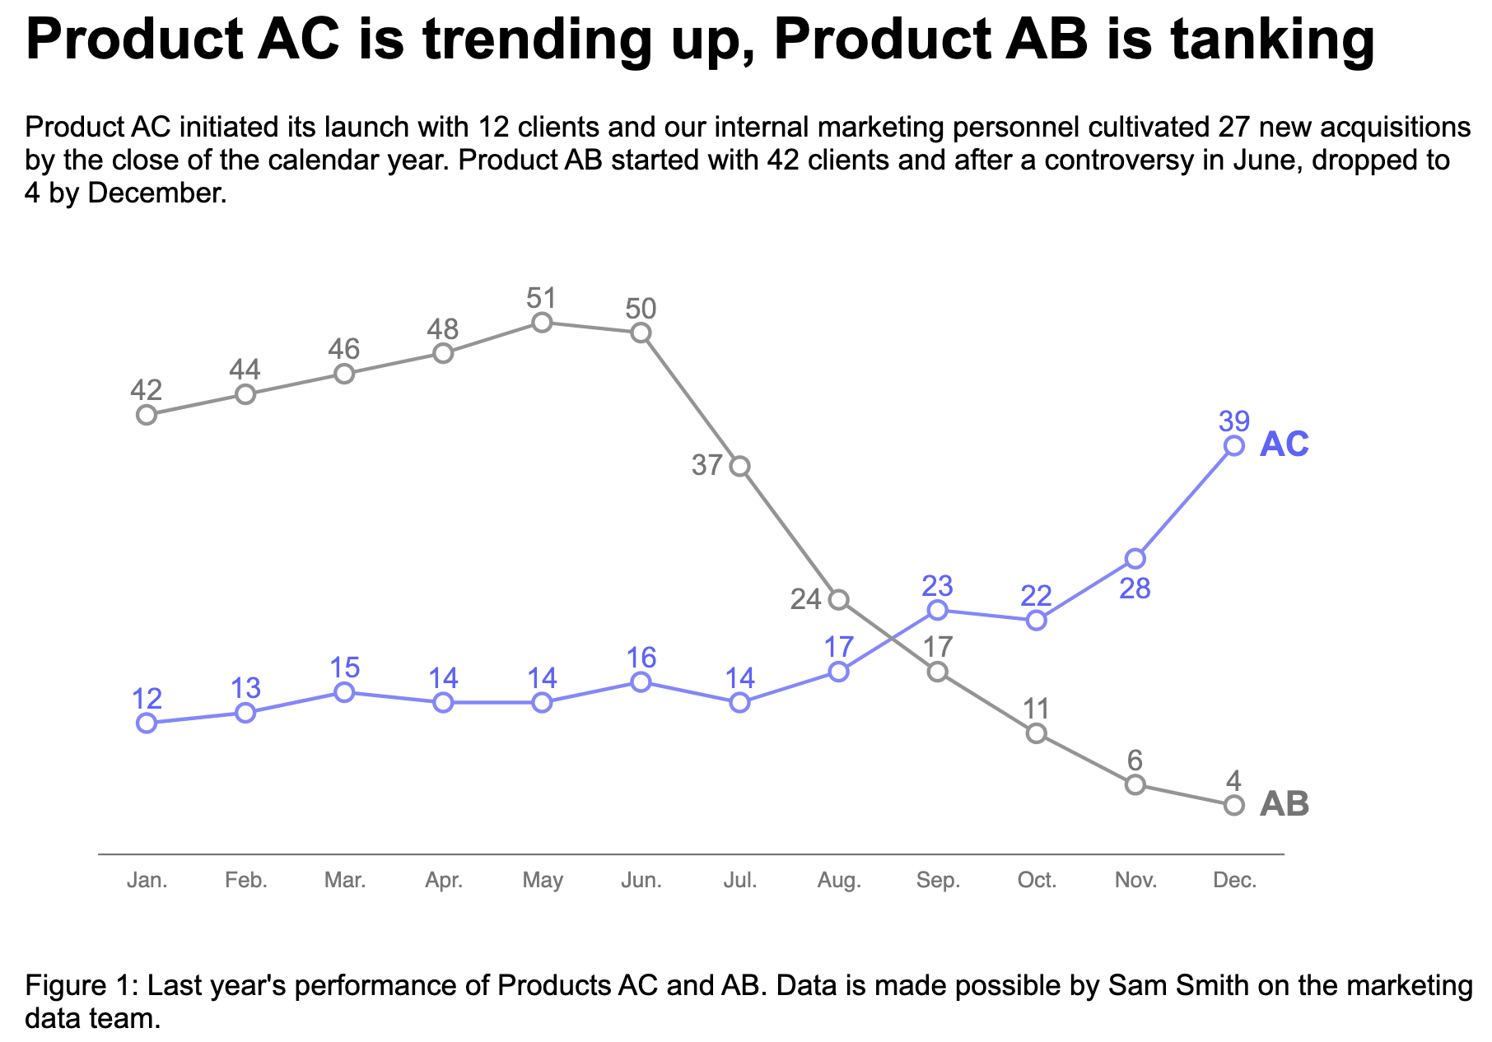
Explore: An interactive bar chart
https://frankelavsky.github.io/assessing_chart_interactivity/

Slide 38
A philosophical question: How do you know something is inaccessible?

Slide 39
Listen to people with disabilities.

Slide 40
There are a lot of ways to listen to PWD:
Actually ask them!
Find where they are already speaking
Find where they have already spoken:
Research
Blog posts
Accessibility standards

Slide 41
The fun part of this talk: The tour!
What’s happening in the broad space of science, research, data, and accessibility right now?

Slide 42
The tour
Let’s look at some cool stuff:
Nasa’s James Webb Telescope captions and image descriptions
Carni Klirs’ Sonification of NYT COVID deaths
arXiv’s Accessibility Forum 2023
Tactile Maps vs 3D Printing Tactile Graphics
Embossed graphics vs Refreshable braille displays

Slide 43
My work
Past:
Visa Chart Components, a library of charts
Chartability, a set of guidelines
Current:
(secret project)
(Demo video of my latest project?)
Refreshable data tactilization interfaces (in progress!)

Slide 44
My goal is to empower practitioners to make their own work more accessible and to challenge the barriers placed on who can be a data practitioner.

Slide 45
Part 2: How do you catch accessibility barriers indata visualizations?
(an introductory guide)

Slide 46
Perceivable
Can someone perceive this in multiple ways? Is each way easy?

Slide 47
Perceivable Checklist:
High Contrast
CVD-Safe + Redundant Encoding
Alt Text

Slide 48
Design with high contrast
Colorblindness Disproportionately Overrepresented in A11y Resources
Colorblindness Disproportionately Overrepresented in A11y Resources
Colorblindness: % of People
Colorblindness: % of People
4%
4%
Low Vision: % of People
Low Vision: % of People
25%
25%
Colorblindness: # of Resources
Colorblindness: # of Resources
51
51
Low Vision: # of Resources
Low Vision: # of Resources
5
5
Notes:
https://projects.susielu.com/viz-palette

Slide 49
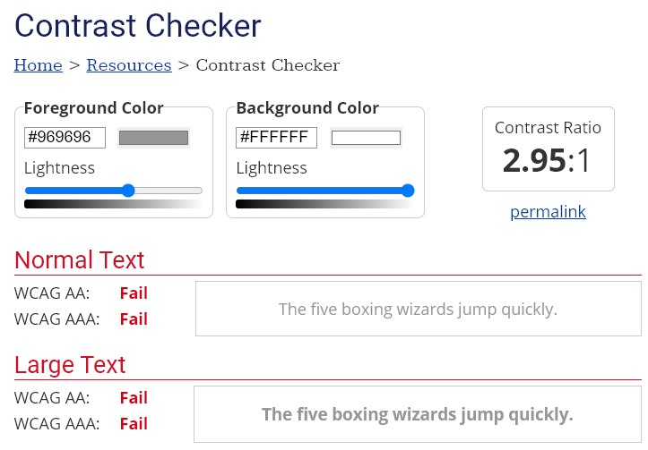
Use High Contrast Text
Text needs at least 4.5:1 contrast against its background.
Large text (bold and 16pt or larger) can be 3:1 or higher.

Slide 50
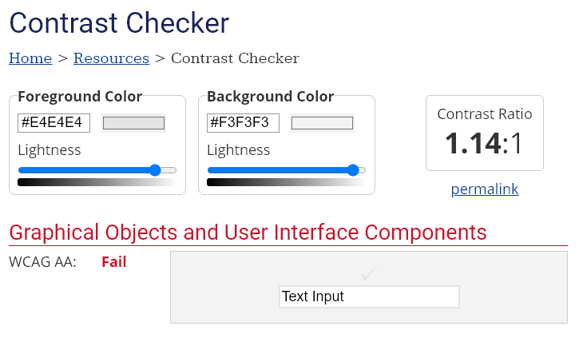
Use High Contrast Geometries
Chart elements need at least 3:1 contrast against their background.

Slide 51
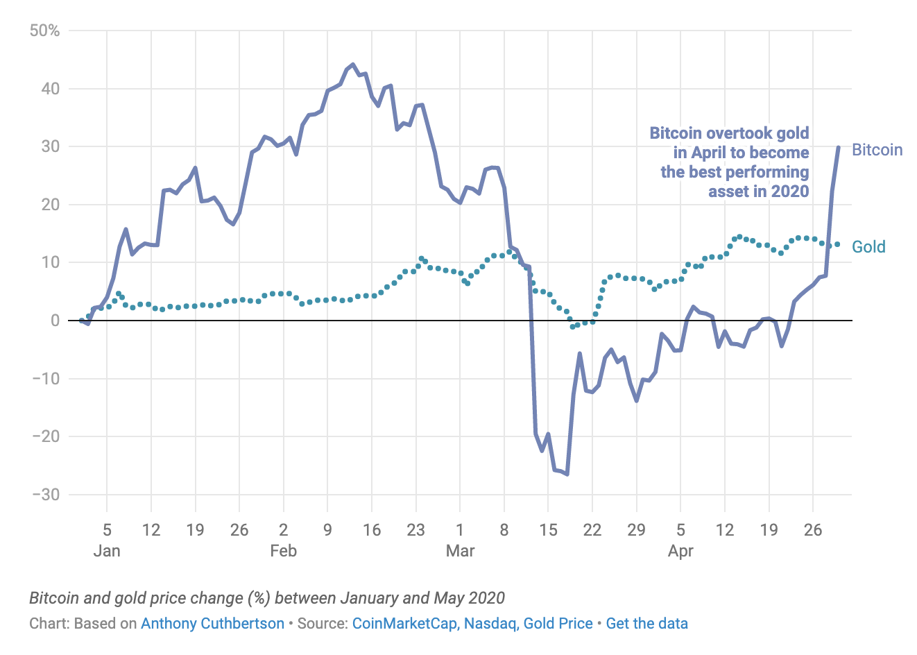
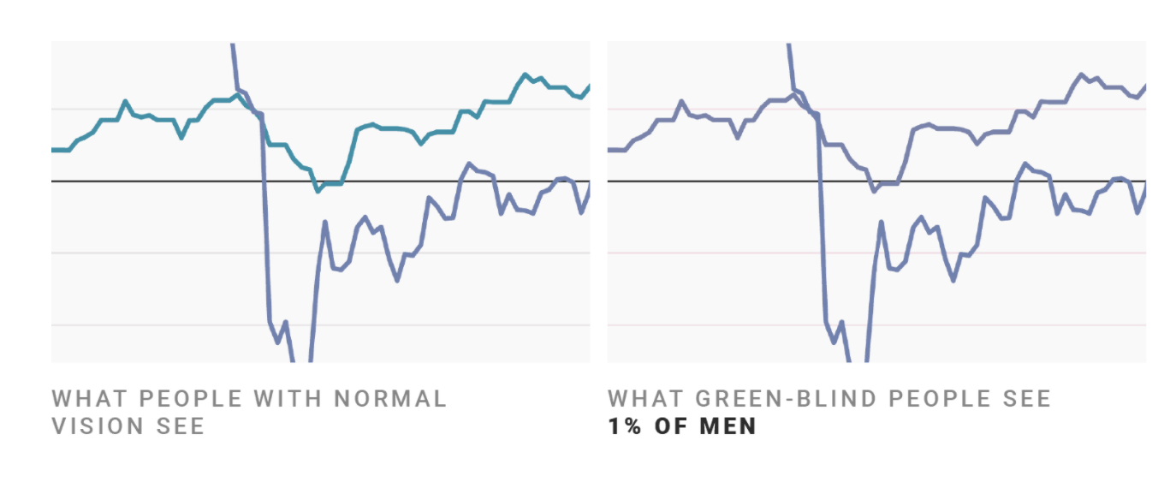
Don’t rely on color alone!
(Muth) https://blog.datawrapper.de/colorblindness-part2/

Slide 52
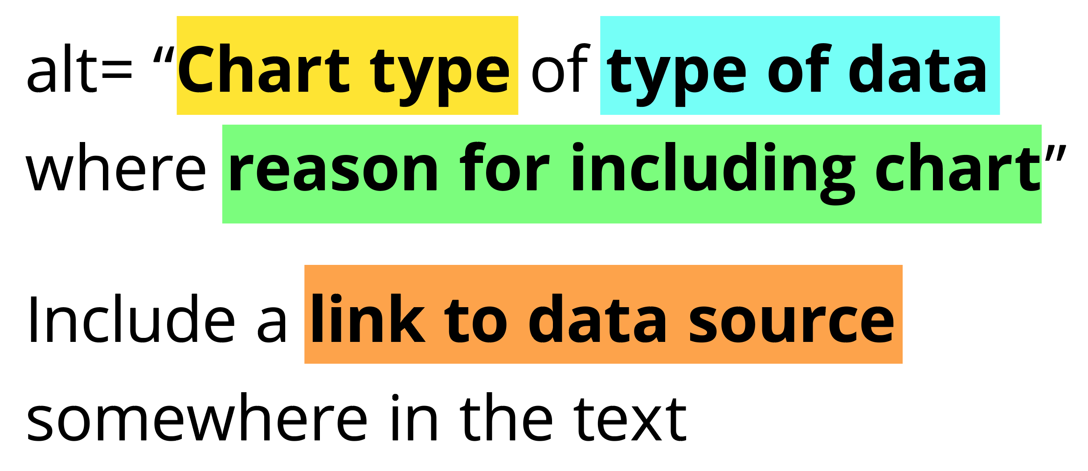
Add alt text
There is great research on alt text, but the most important thing to know is that you should add it to every image you post online (including twitter), in a document, or presentation.
Guidance: https://medium.com/nightingale/writing-alt-text-for-data-visualization-2a218ef43f81

Slide 53
Perceivable Evaluation Toolkit:
Contrast Checker
Safe color design
CVD Checker
Redundant encoding design ideas
Alt Text

Slide 54
Operable
Can someone operate this in multiple ways? Is each way easy?

Slide 55
Operable Checklist:
Mouse
Keyboard-only
Screen Reader

Slide 56
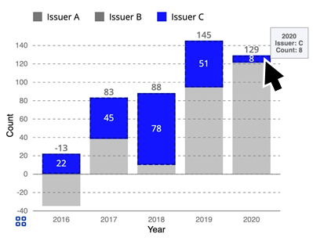
Ensure Keyboard Access (if interactive)

Slide 57
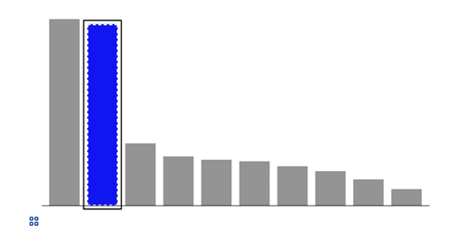
Indicate keyboard focus, use multi-modal style
This is a keyboard focus indicator (outer border) with the same styling effect applied on mouse hover (inner dashed white lines and blue fill)

Slide 58
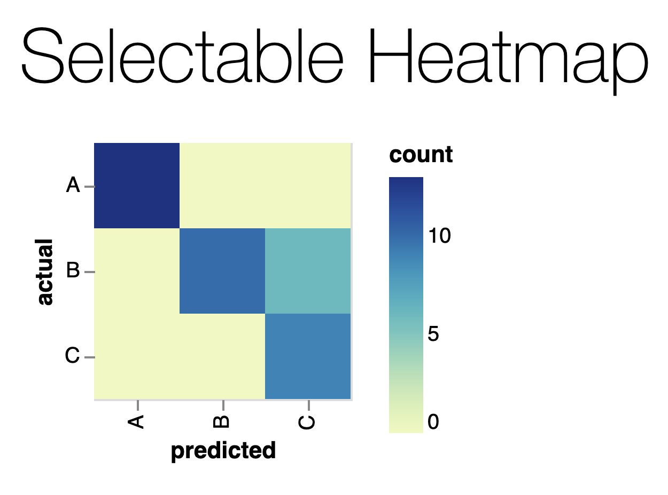
Why Keyboard-only?
Some things work for screen readers but not for keyboard-only users!
https://vega.github.io/vega-lite/examples/selection_heatmap.html

Slide 59
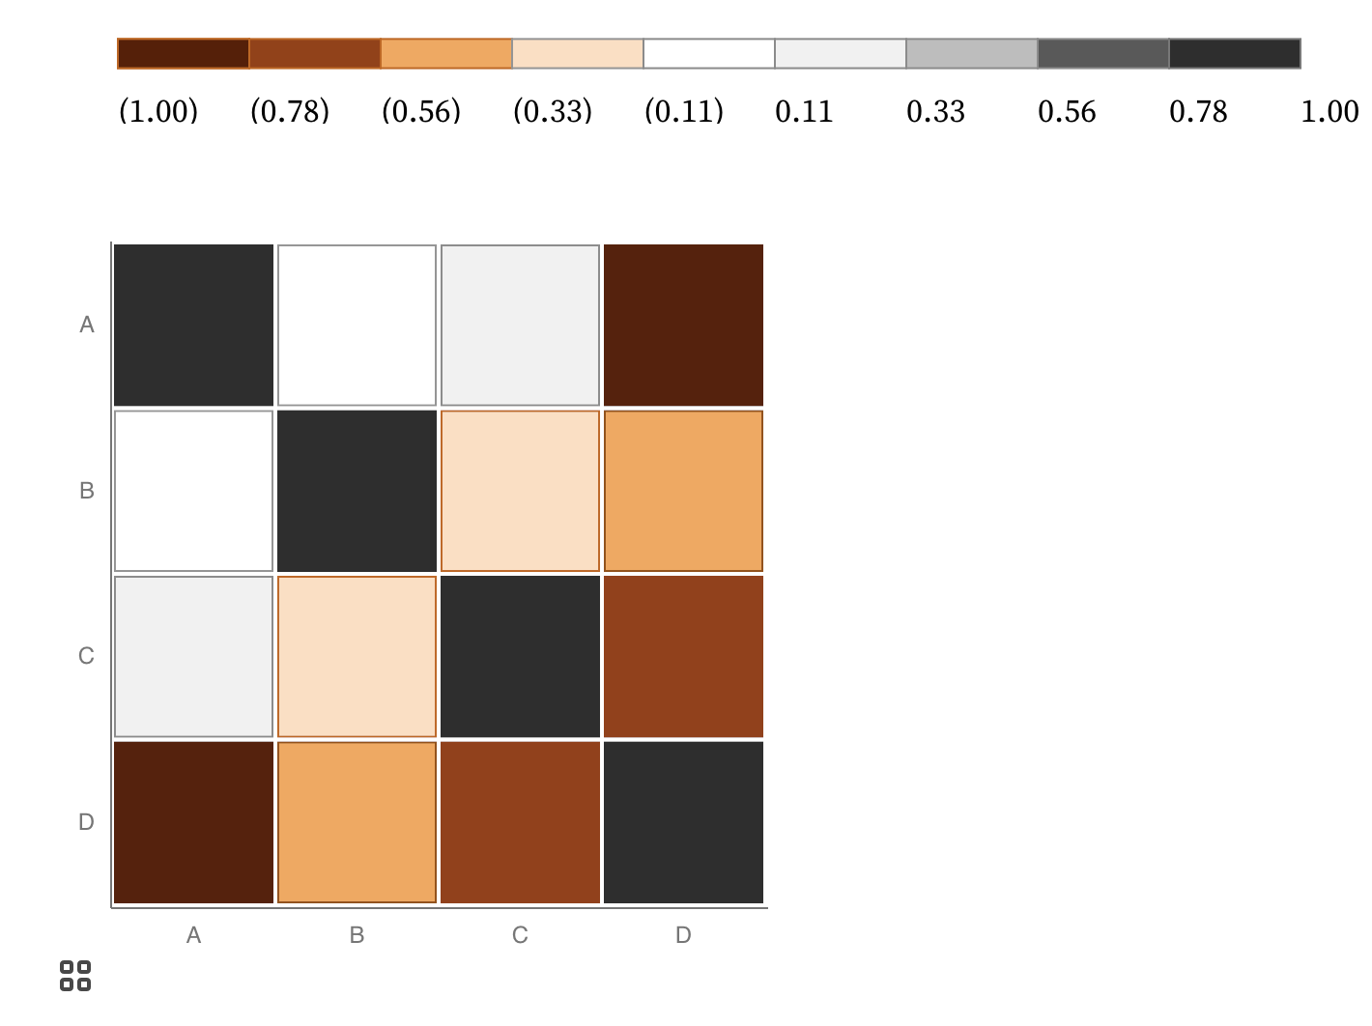
Keyboard only example:
https://observablehq.com/@frankelavsky/experimental-color-scale-textures

Slide 60
Operable Evaluation Toolkit:
Use your mouse: can it do something meaningful? (tooltip, click event, etc) If so:
Test using a keyboard-only: can you navigate and use keyboard activation (spacebar/enter) on the visualization?
Test using a screen reader: Can you use a screen reader to navigate and use keyboard activation on the visualization?

Slide 61
Understandable
Can someone understand this in multiple ways? Is each way easy?

Slide 62
Understandable Checklist:
Descriptive title, summary, or caption
Data table or data download
Reading level

Slide 63
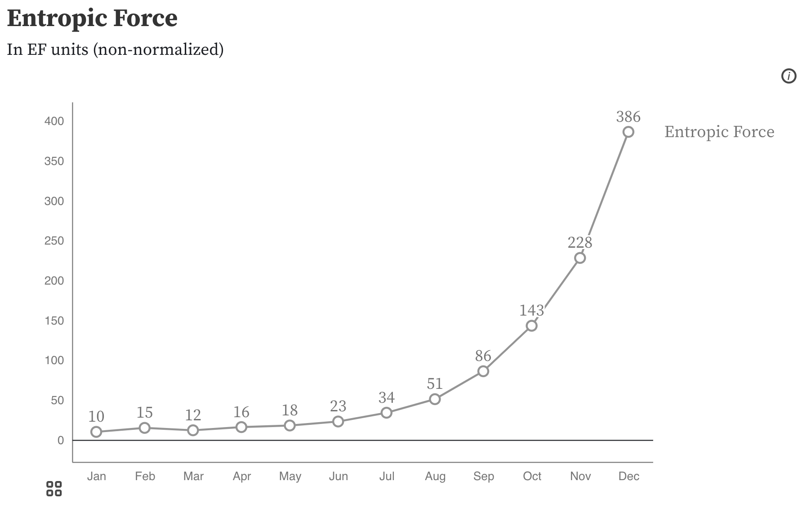
Non-descriptive titles are inaccessible

Slide 64
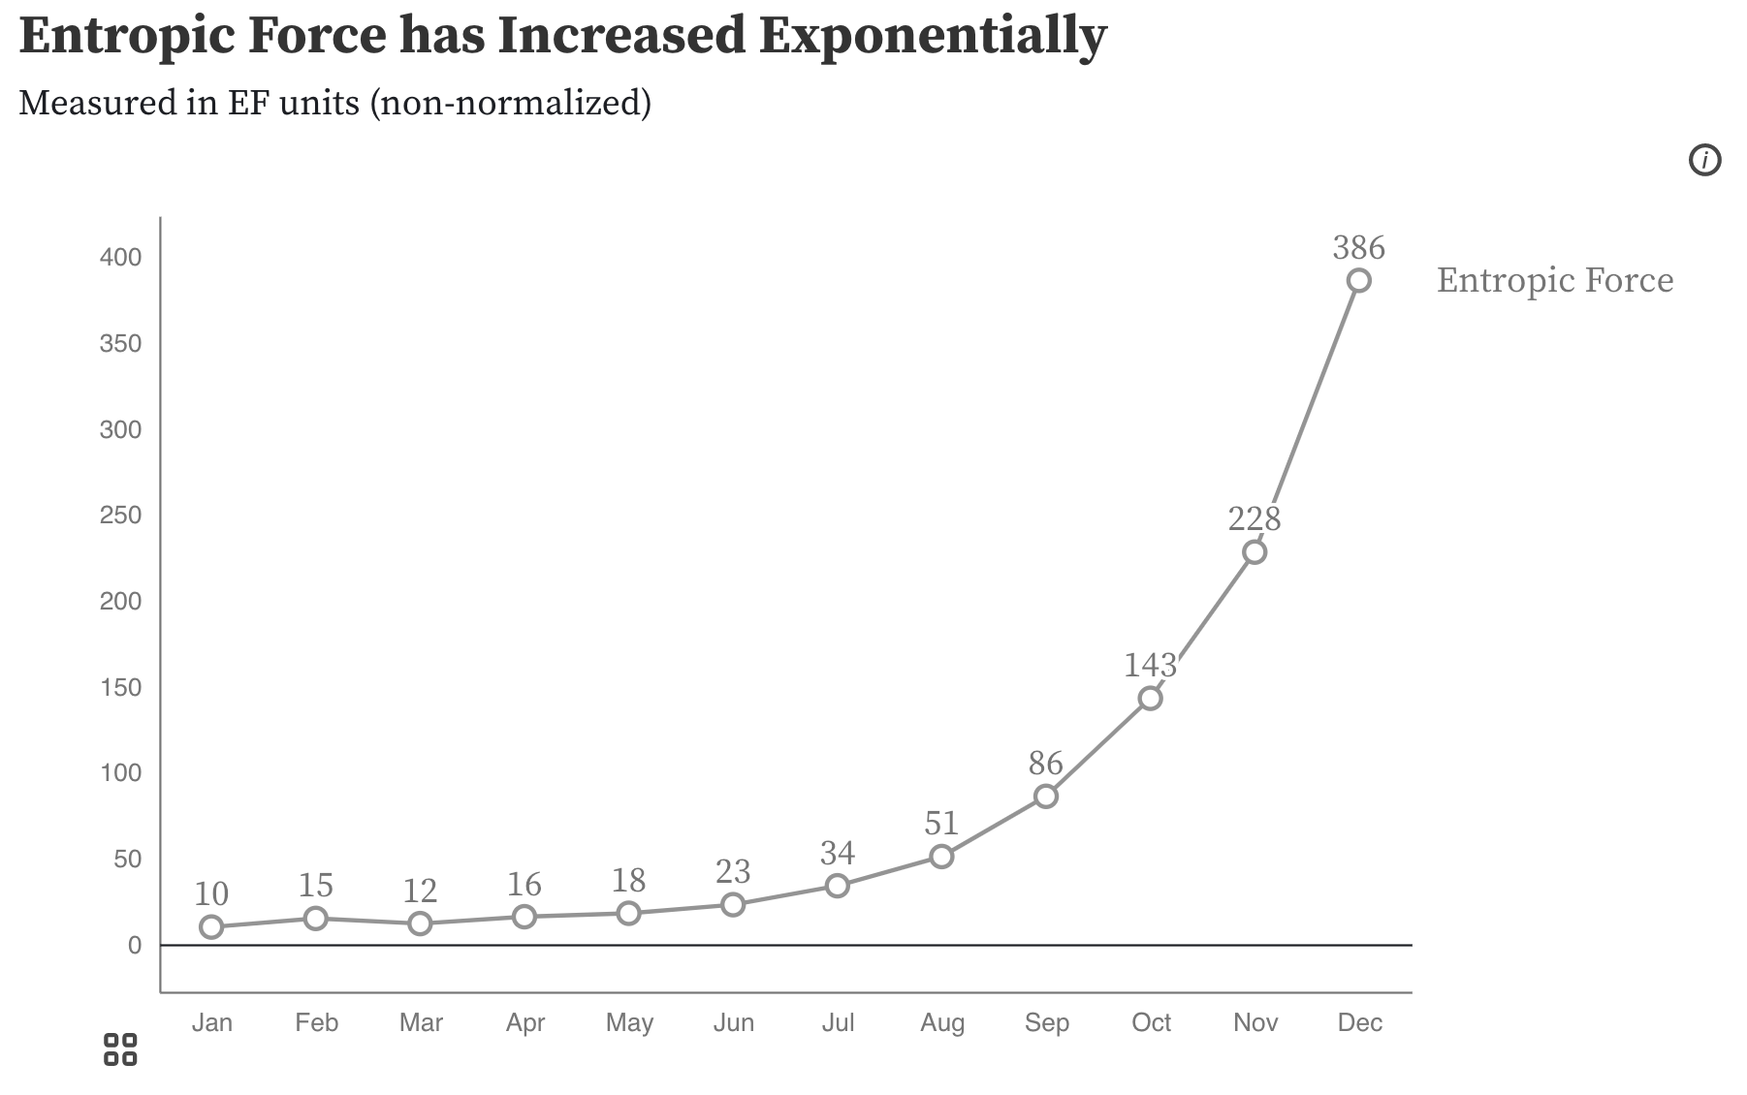
Descriptive titles have summaries/takeaways

Slide 65
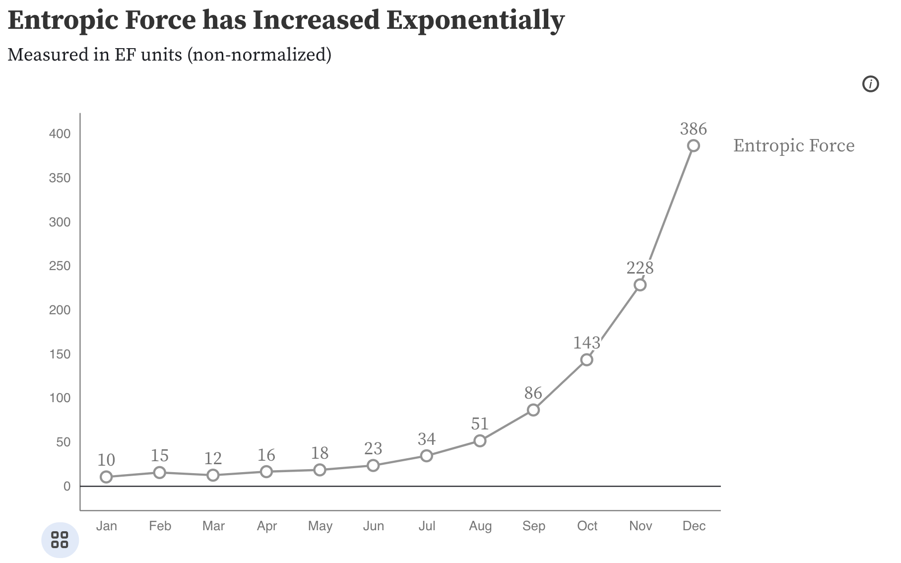
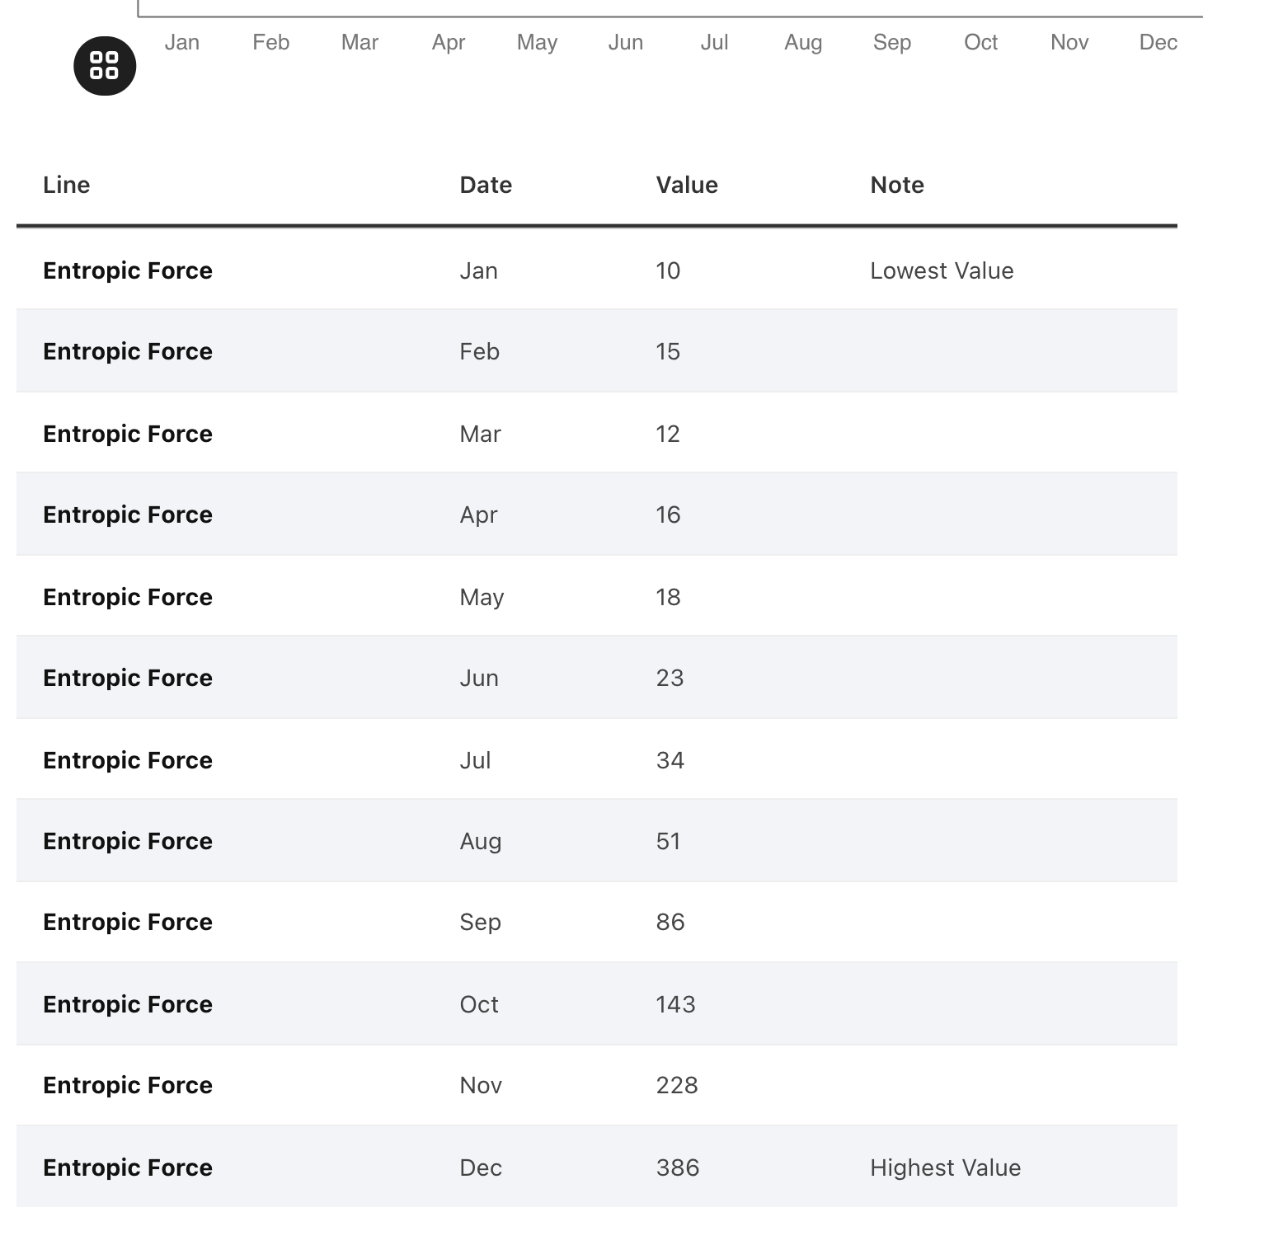
All charts should have data available!

Slide 66
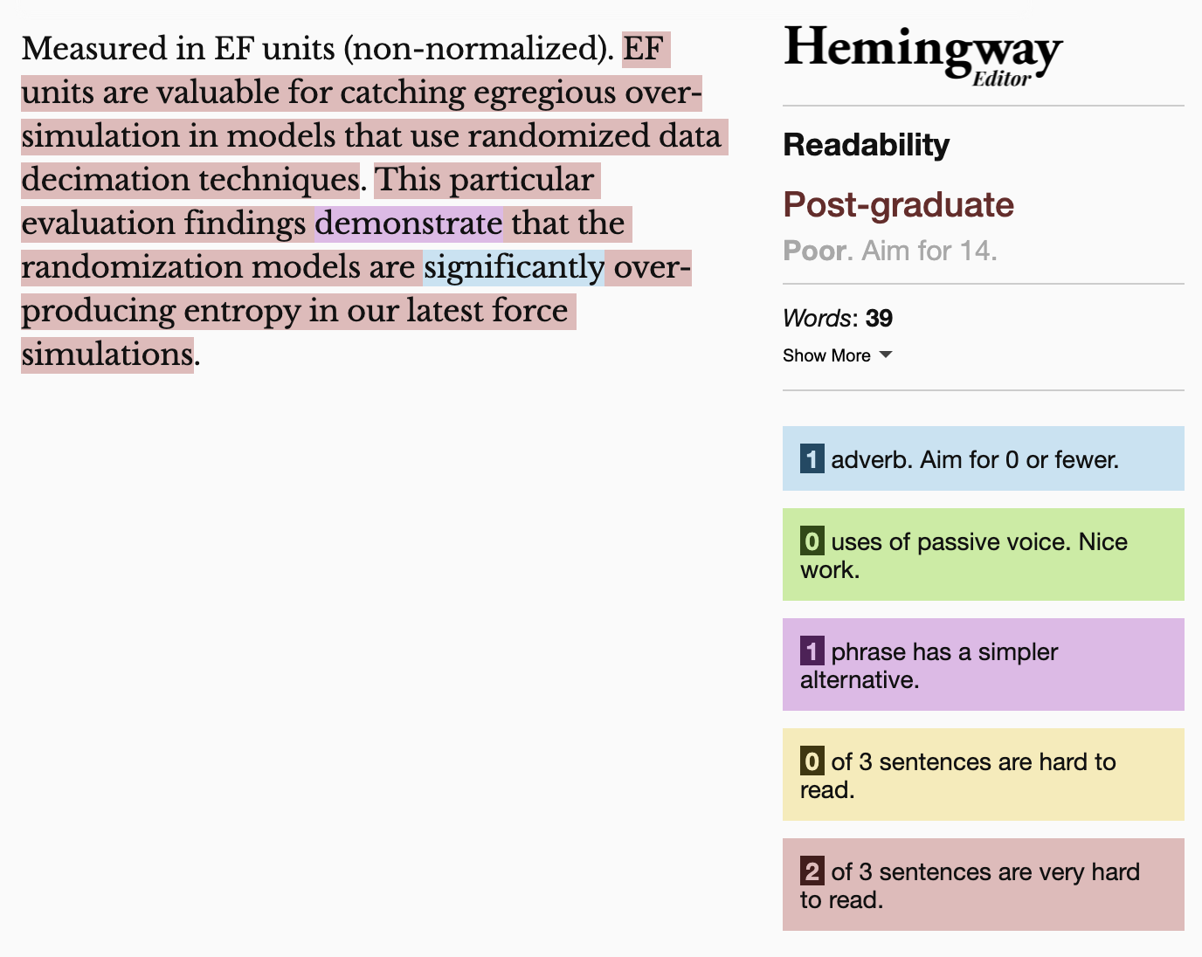
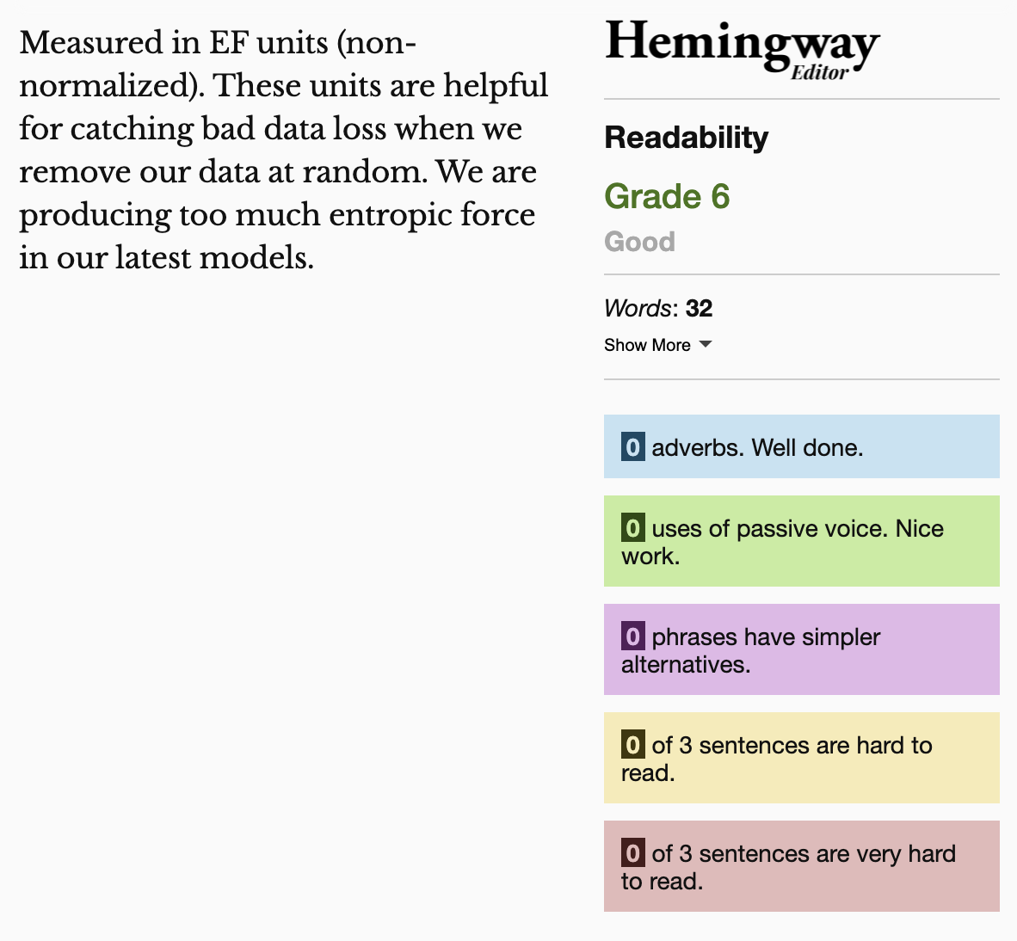
Keep summaries as non-technical as possible
If the topic is technical, provide a “plain language” summary somewhere close by that is easy to find (either in the same location or with by providing a link).

Slide 67
Understandable Evaluation Toolkit:
Is there a descriptive title, summary, or caption?
Is there an accessible table or downloadable data file provided?
Is the descriptive text supporting the visualization presented at a reading level at grade 9 or below?

Slide 68
Part 3: Hands-on making!
Let’s make some accessible data representations.

